Slide 1
Statistical Reasoning
Course Code: CSC4226
Course Title: Artificial Intelligence and Expert System
Dept. of Computer Science
Faculty of Science and Technology
Lecture No: | Ten (10) | Week No: | Eleven(11) | Semester:
Lecturer: | Dr. Muhammad Firoz Mridha, Associate Professor, Dept of CS Email: firoz.mridha@aiub.edu

Slide 2
Lecture Outline
Quantifying Uncertainty
Basic Probability Notation
Bayes’ Rules and Its Use
Clinical Trials
The Semantics of Bayesian Network
Prediction in Bayesian Netwrok

Slide 3
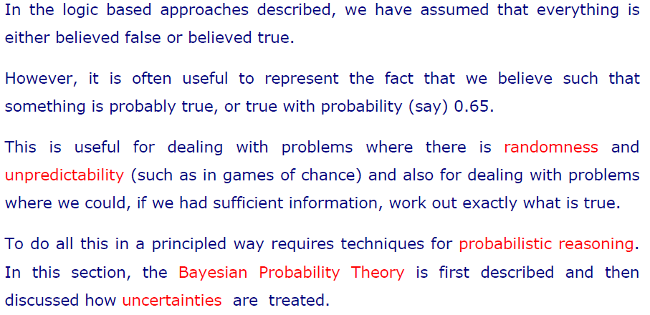
Quantifying Uncertainty

Slide 4
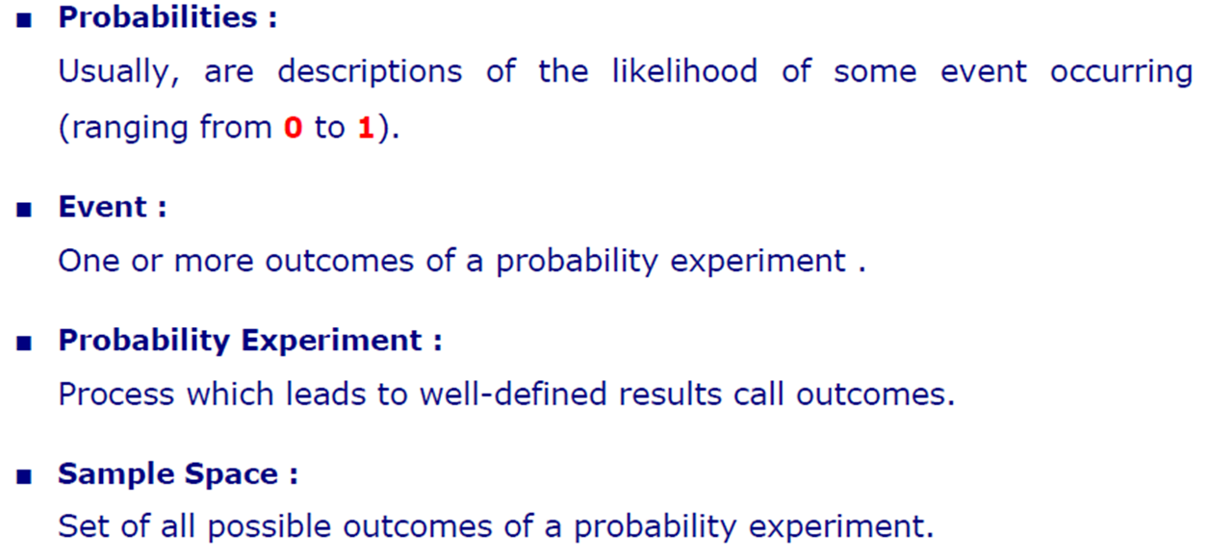
Basic Probability Notations

Slide 5
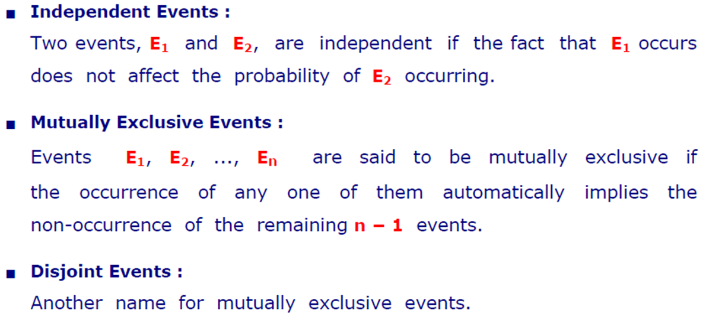
Basic Probability Notations

Slide 6
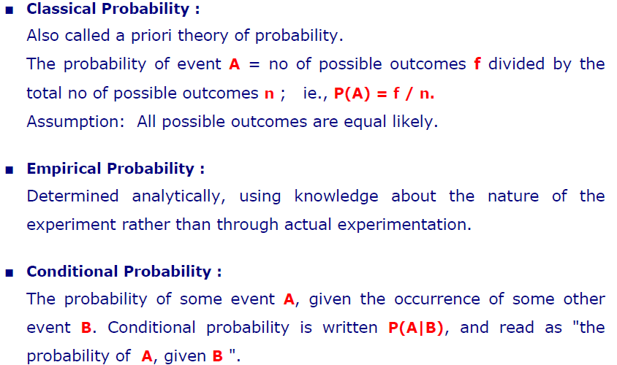
Basic Probability Notations

Slide 7
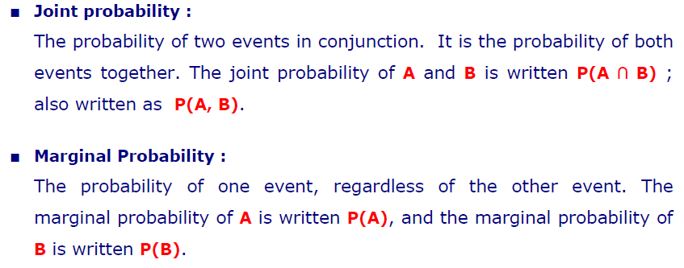
Basic Probability Notations

Slide 8
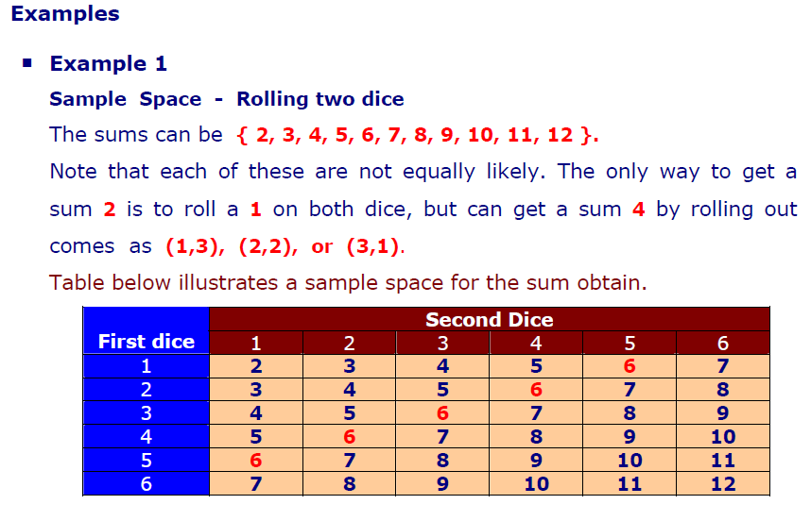
Examples

Slide 9
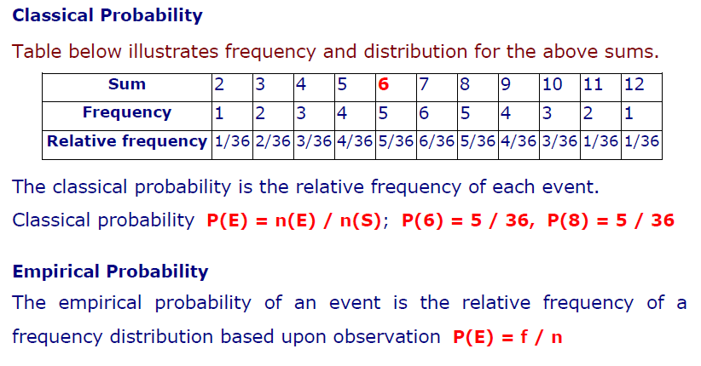
Classical & Empirical Probability

Slide 10
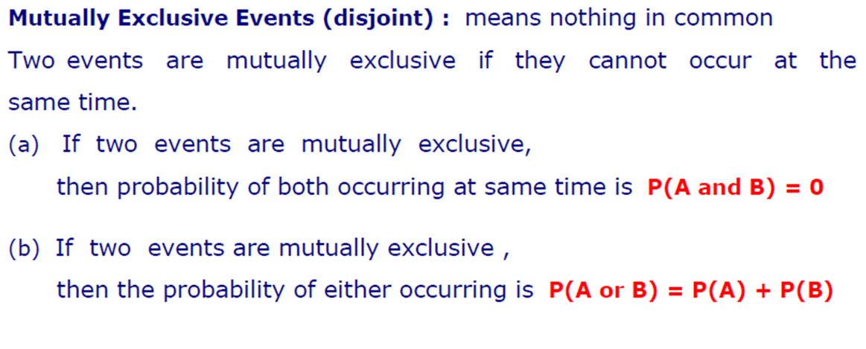
Disjoint Events

Slide 11
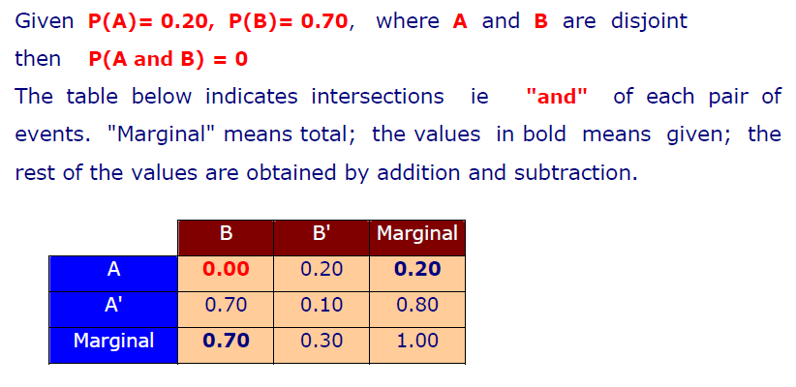
Example

Slide 12
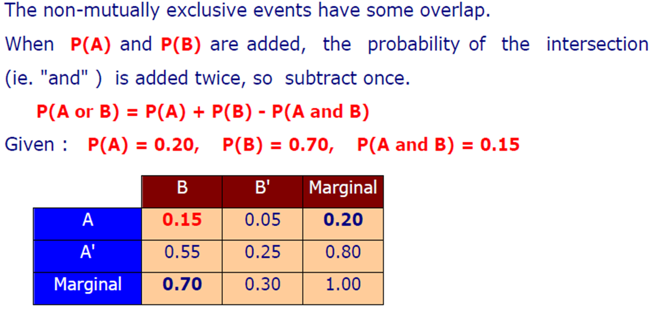
Non-Mutually Exclusive Events

Slide 13
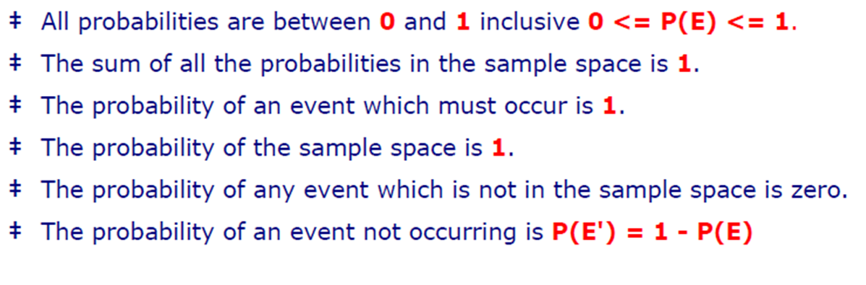
Probability Rules

Slide 14
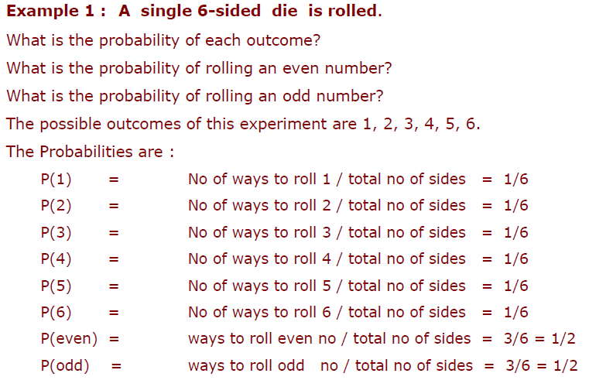
Practice 1

Slide 15
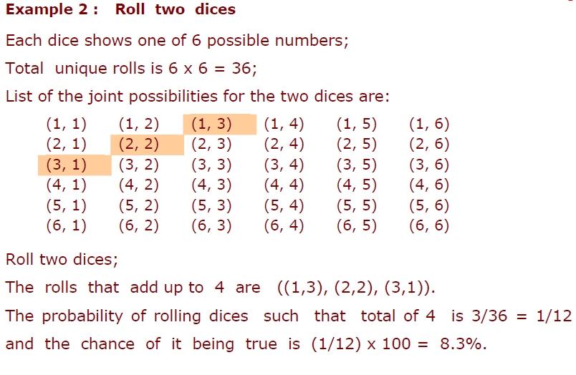
Practice 2

Slide 16
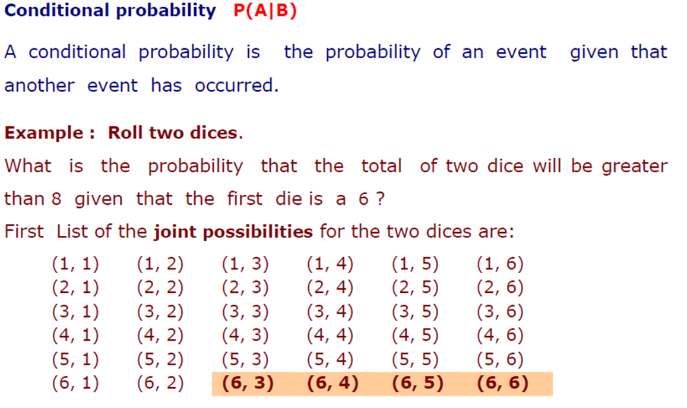
Conditional Probability

Slide 17
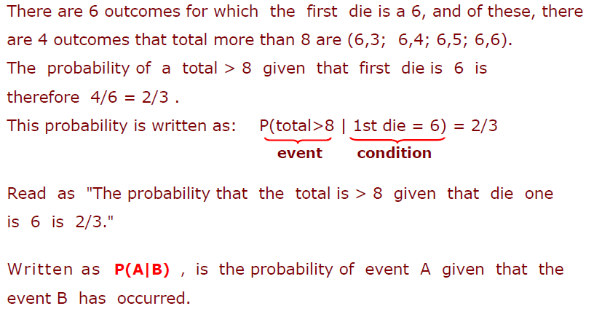

Slide 18
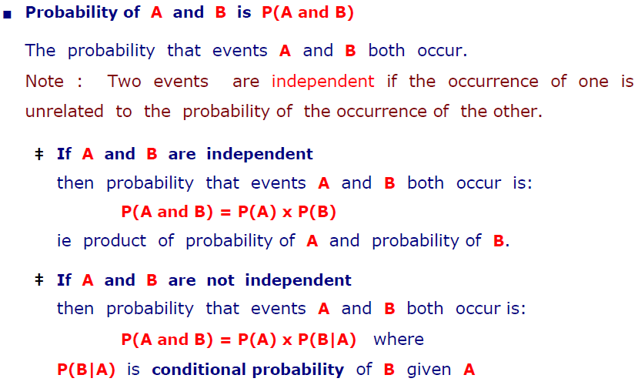
Joint Probability

Slide 19
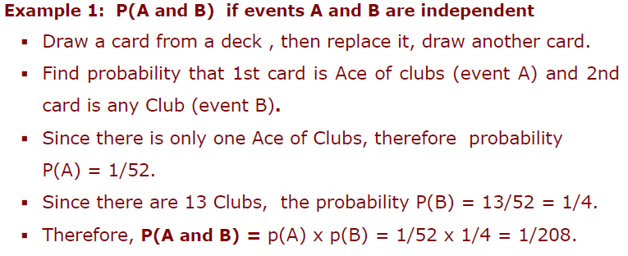
Joint Probability : Independent Events

Slide 20
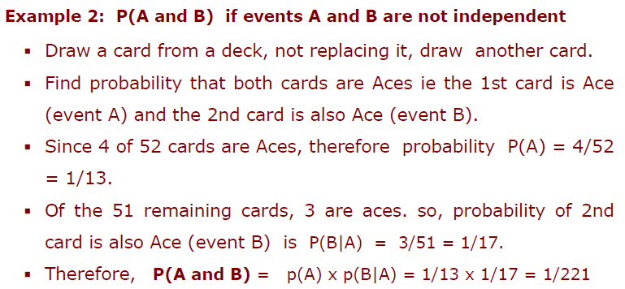
Joint Probability : Dependent Events

Slide 21
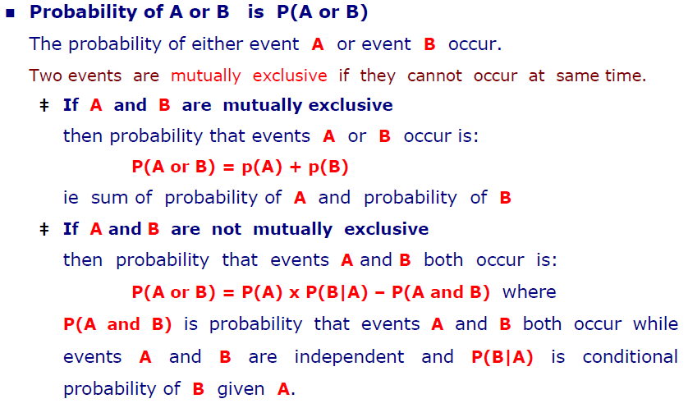
OR Operation

Slide 22
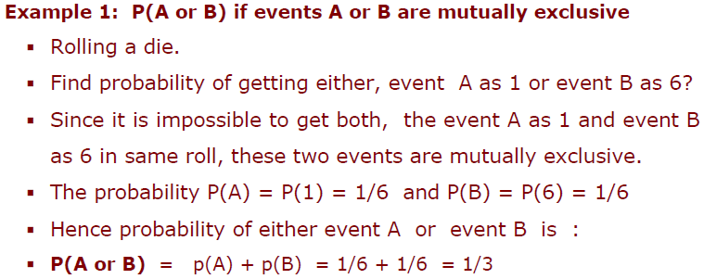
OR Operation: Mutually Exclusive

Slide 23
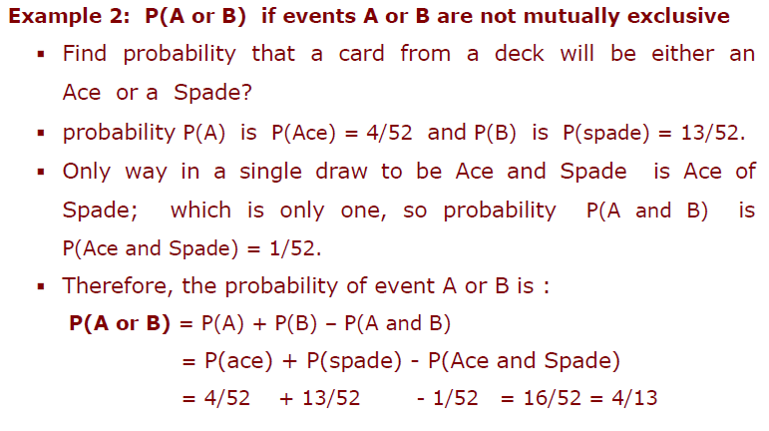
OR Operation: Not Mutually Exclusive

Slide 24
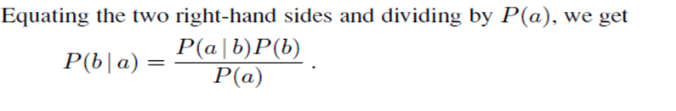
Bayes’ Rule
Product rule can be written in two forms
This equation is known as Bayes’ rule (also Bayes’ law or Bayes’ theorem).
This simple equation underlies most modern AI systems for probabilistic inference.

Slide 25
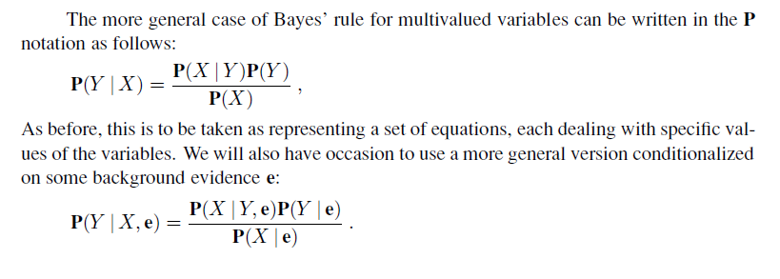
General Case of Bayes’ Rule

Slide 26
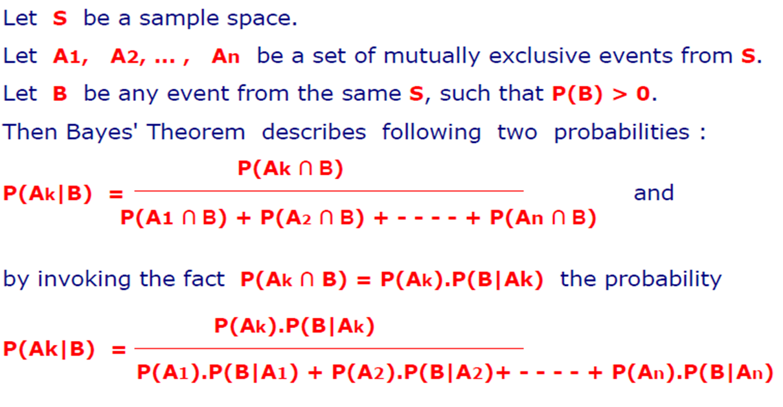
Bayes’ Theorem: Revisited

Slide 27
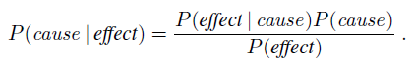
Applying Bayes’ rule: The simple case
The conditional probability P(effect | cause) quantifies the relationship in the causal direction,
whereas P(cause | effect) describes the diagnostic direction
In a task such as medical diagnosis, we often have conditional probabilities on causal relationships (that is, the doctor knows P(symptoms | disease)) and want to derive a diagnosis, P(disease | symptoms).

Slide 28
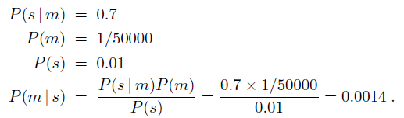
Applying Bayes’ rule: A Simple Example
A doctor knows that
the disease meningitis causes the patient to have a stiff neck, say, 70% of the time.
The doctor also knows some unconditional facts: the prior probability
that a patient has meningitis is 1/50,000,
and the prior probability that any patient has a stiff neck is 1%.
Letting
s be the proposition that the patient has a stiff neck and
m be the proposition that the patient has meningitis, we have

Slide 29
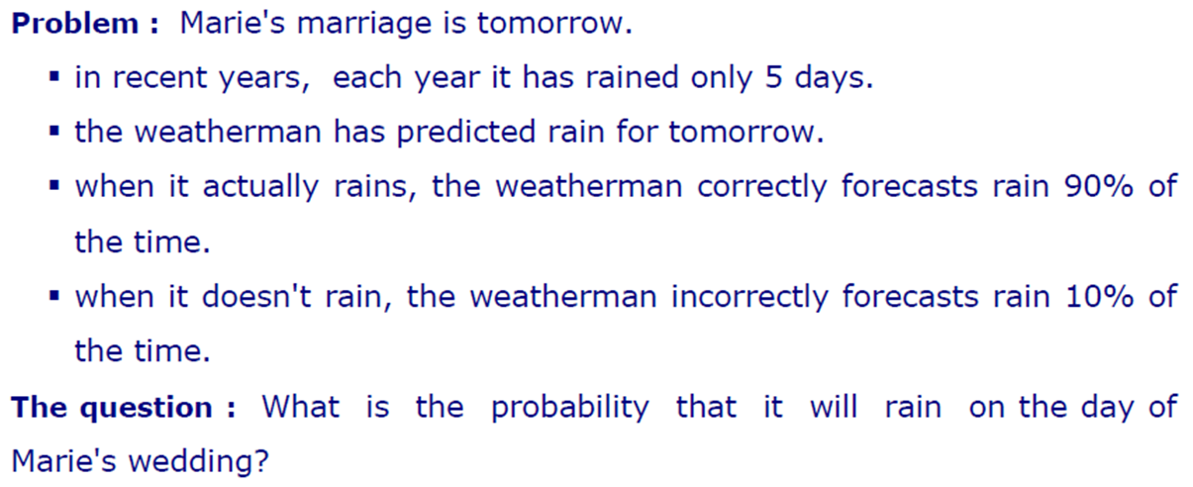
Another Example

Slide 30
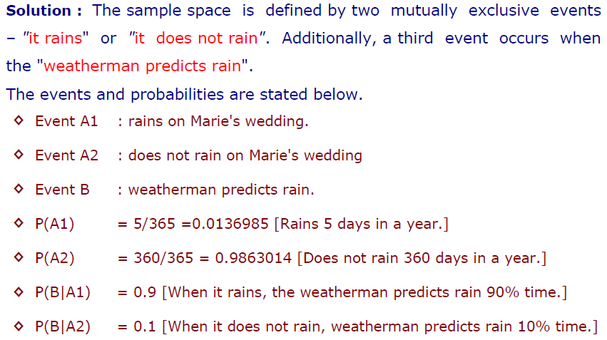
Solution

Slide 31
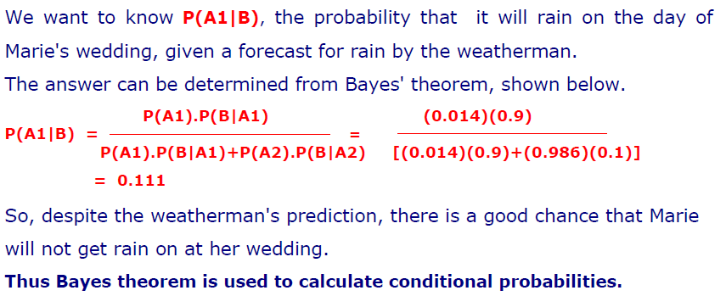
Calculation

Slide 32
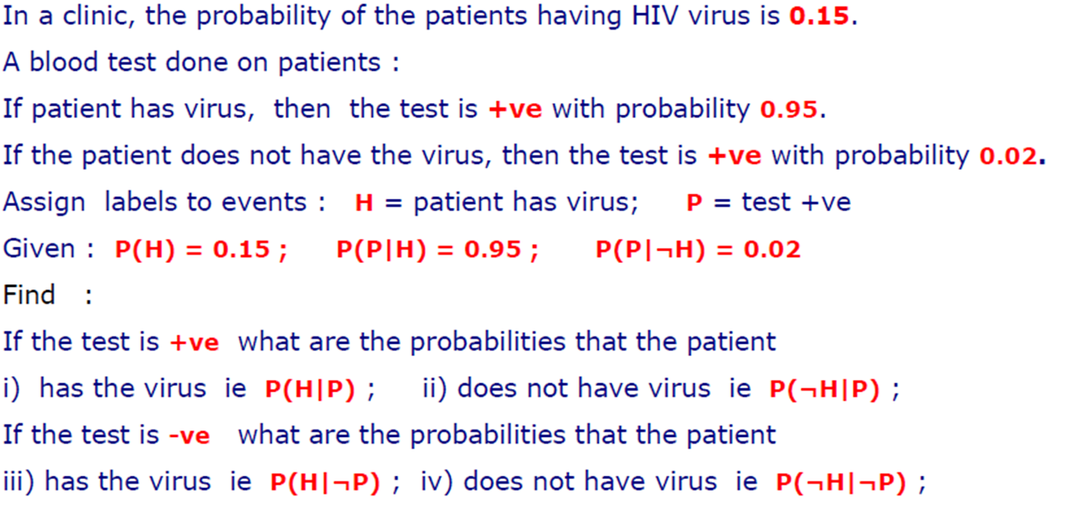
Example: Clinical Trial

Slide 33
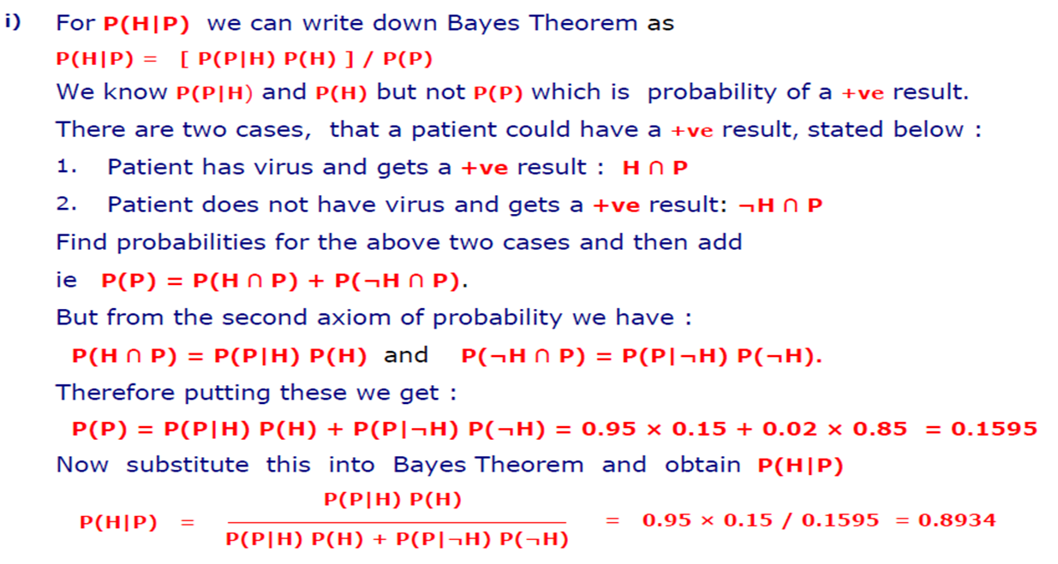
Calculations

Slide 34
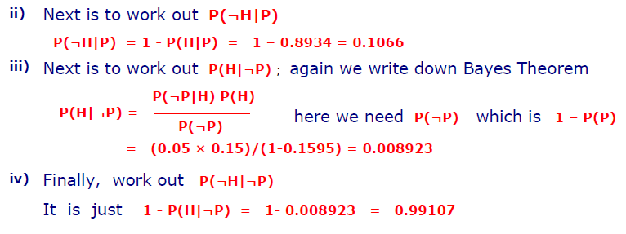
Calculations

Slide 35
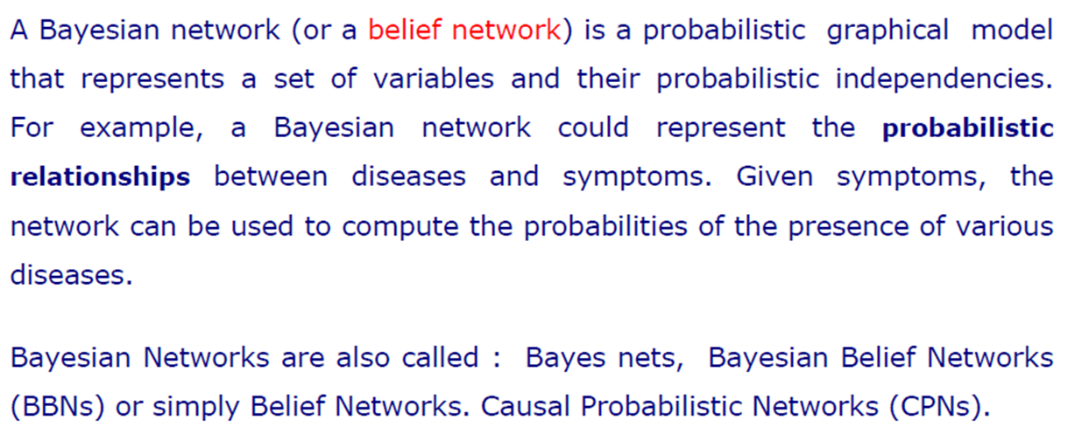
Bayesian Networks

Slide 36
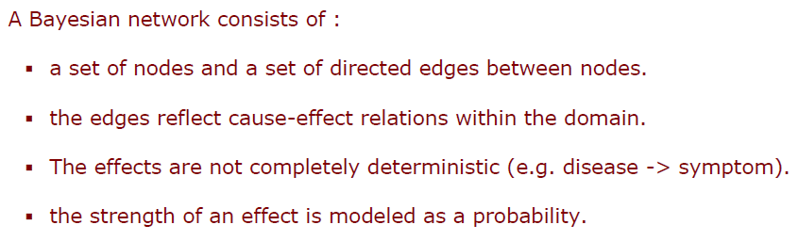
Components of Bayesian Network

Slide 37
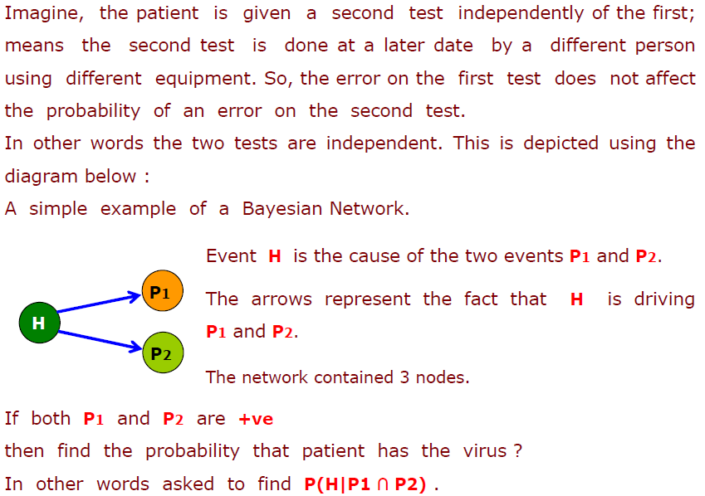
Bayesian Network: Clinical Trial Example

Slide 38
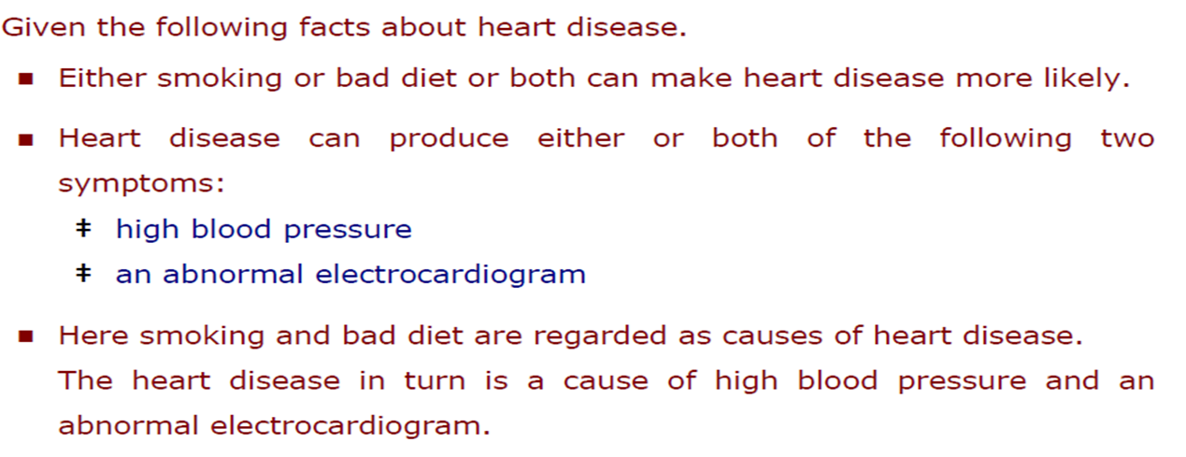
Complicated Bayesian Network

Slide 39
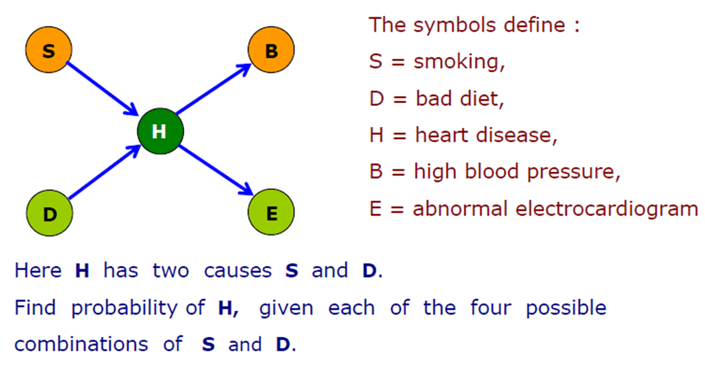
Network of Heart Disease

Slide 40
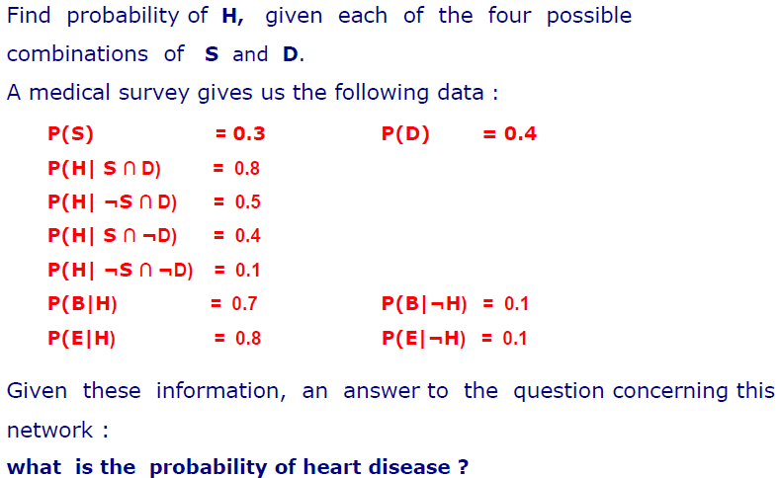
Practice Question

Slide 41
References
Chapter 13: Quantifying Uncertainty , Pages 480-530
“Artificial Intelligence: A Modern Approach,” by Stuart J. Russell and Peter Norvig

Slide 42
Books
“Artificial Intelligence: A Modern Approach,” by Stuart J. Russell and Peter Norvig.
"Artificial Intelligence: Structures and Strategies for Complex Problem Solving", by George F. Luger, (2002)
"Artificial Intelligence: Theory and Practice", by Thomas Dean.
"AI: A New Synthesis", by Nils J. Nilsson.
“Programming for machine learning,” by J. Ross Quinlan,
“Neural Computing Theory and Practice,” by Philip D. Wasserman, .
“Neural Network Design,” by Martin T. Hagan, Howard B. Demuth, Mark H. Beale, .
“Practical Genetic Algorithms,” by Randy L. Haupt and Sue Ellen Haupt.
“Genetic Algorithms in Search, optimization and Machine learning,” by David E. Goldberg.
"Computational Intelligence: A Logical Approach", by David Poole, Alan Mackworth, and Randy Goebel.
“Introduction to Turbo Prolog”, by Carl Townsend.

